Slide 1
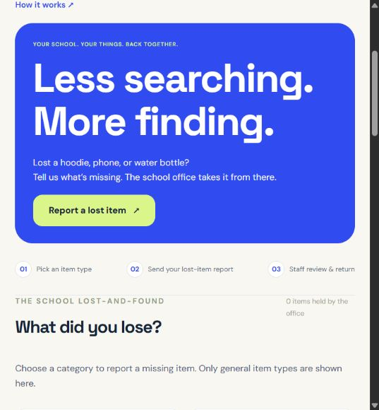
FOUNDIT / SIERRA SHOWCASE
A school lost-and-found for Sierra
Less searching.
More finding.
Students report a loss.
School staff review possible matches.
SIERRA’S NEW SCHOOL CODE
sierra-70912b
01 / 11
Notes:
Sierra workspace created on the live FoundIt site for this showcase. Public school code: sierra-70912b. Staff password is private. The workflow demonstration uses isolated fictional records. Source: current application and https://foundit.lunarelevation.com/.

Slide 2
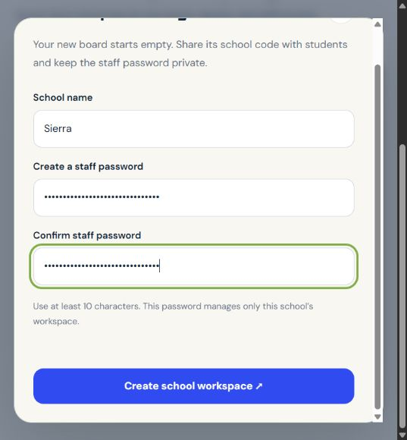
FOUNDIT / SIERRA SHOWCASE
1. Create a school workspace
Enter the school name
and a staff password.
FoundIt creates an empty board
with a unique school code.
Each school keeps its own
items and lost-item reports.
02 / 11
Notes:
Actual Sierra registration screen. Password values are masked. School records are scoped by school_id in the database. No school affiliation or pilot is claimed. Source: school_app.py and current interface.

Slide 3
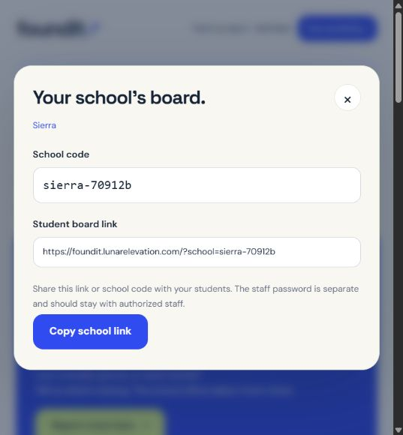
FOUNDIT / SIERRA SHOWCASE
2. Sierra’s school code is ready
sierra-70912b
Students use the code or link
to open Sierra’s board.
Staff sign in with this code
and their separate password.
03 / 11
Notes:
This is the real generated Sierra code. Board link: https://foundit.lunarelevation.com/?school=sierra-70912b. The generated staff credential is excluded from all public media.

Slide 4
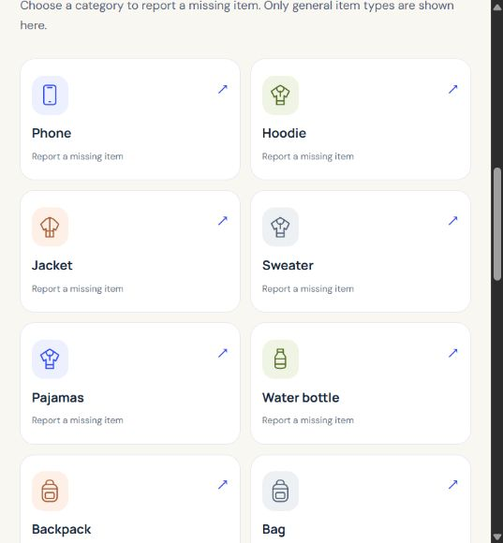
FOUNDIT / SIERRA SHOWCASE
3. Browse simple item categories
Phone. Hoodie. Notebook.
Other, when needed.
The public board shows general
item types. Found photos and
locations stay with staff.
19 categories, with no student account required.
04 / 11
Notes:
Live Sierra category board. The public API omits identifying descriptions, found photos, locations, and found dates. Student access requires selecting a school by its code or link. Source: current school_app.py public item serializer.

Slide 5
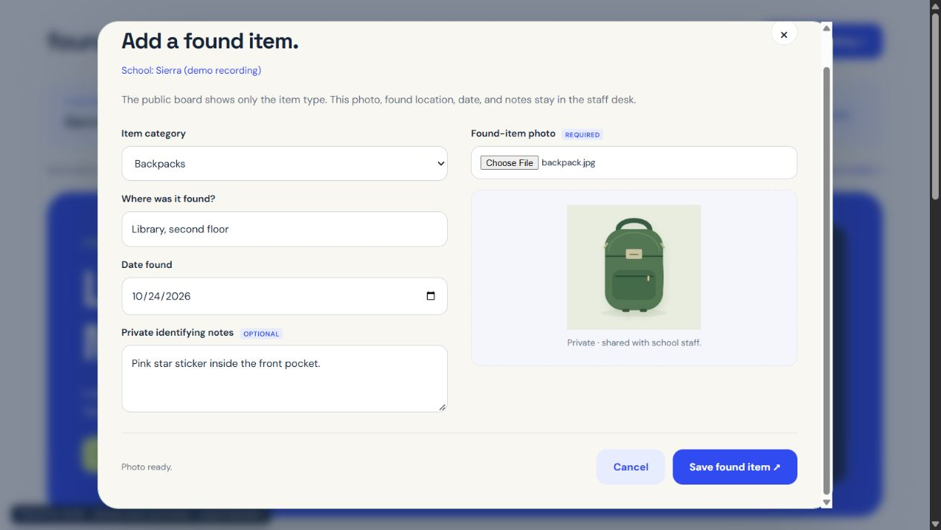
FOUNDIT / SIERRA SHOWCASE
4. Staff record the found item
Staff add the category, photo, found location, date, and optional private notes.
Fictional workflow example using an original sample illustration. The score does not establish ownership.
05 / 11
Notes:
Isolated fictional example. Current production code handles this form; a local wrapper labels the recording as a demo. No demonstration items were added to the live Sierra board.

Slide 6
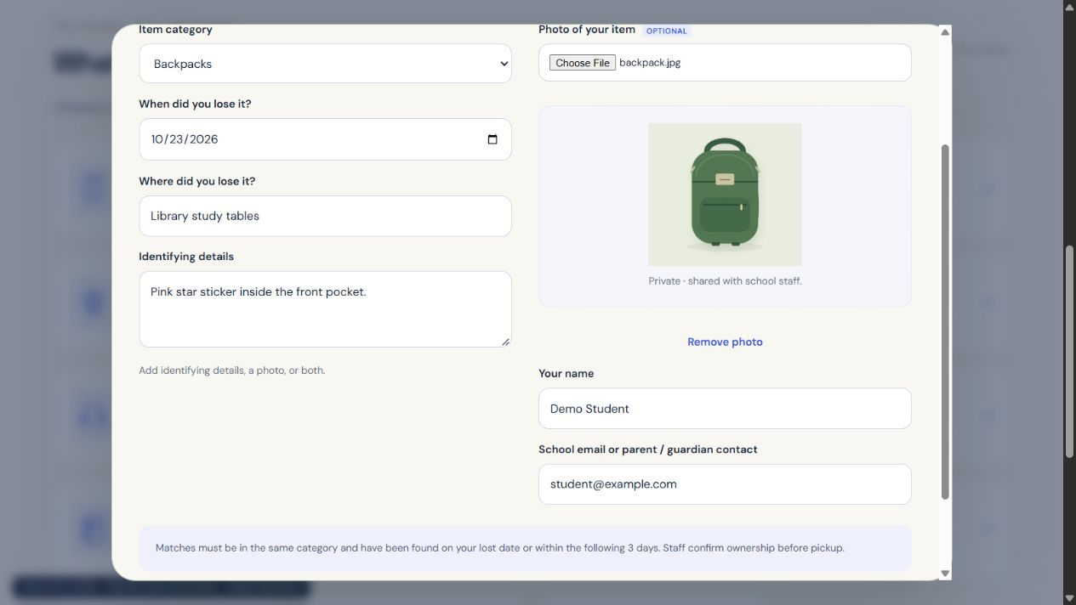
FOUNDIT / SIERRA SHOWCASE
5. Students report what they lost
Students send a lost date, location, identifying details, and an optional photo.
Fictional workflow example using an original sample illustration. The score does not establish ownership.
06 / 11
Notes:
The student receives no similarity percentage or private found-item information. Details and photos go to their selected school only. Example student name and contact are fictional.

Slide 7
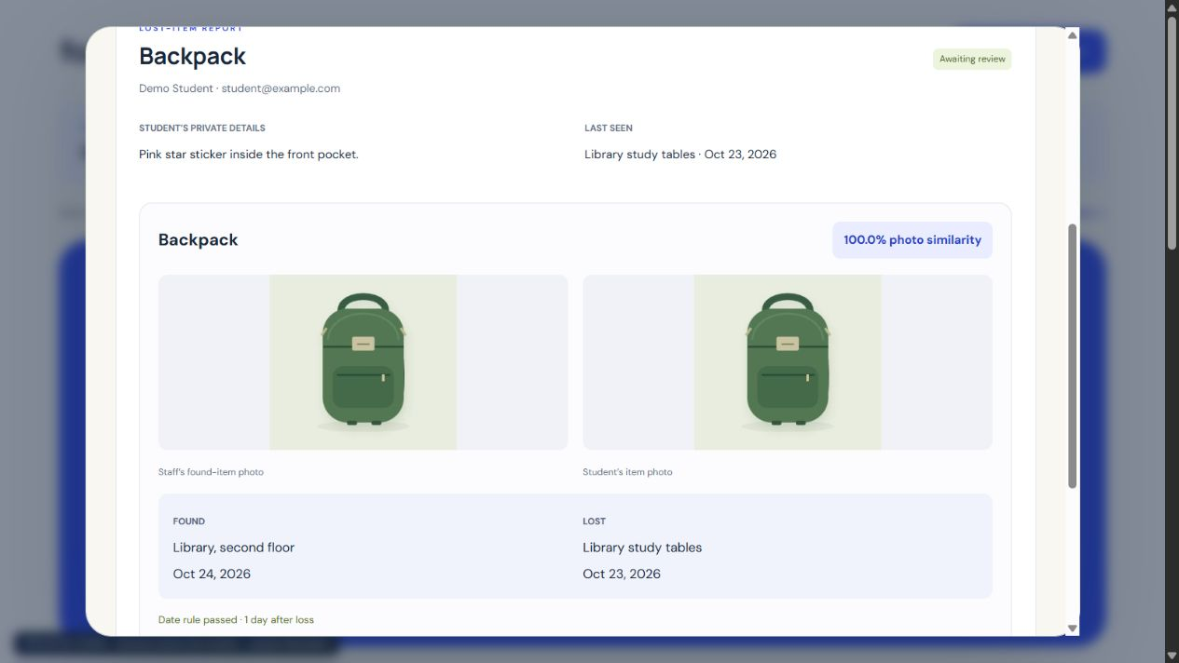
FOUNDIT / SIERRA SHOWCASE
6. The server compares eligible photos
Same school and category. Found on the lost date or within the following 3 days.
Fictional workflow example using an original sample illustration. The score does not establish ownership.
07 / 11
Notes:
The displayed 100.0% is the actual server result on reused sample artwork. It is a demonstration of the pipeline, not real-photo accuracy or proof of ownership. MobileNetV2 image features are compared using cosine similarity. Model: https://huggingface.co/onnxmodelzoo/mobilenetv2-12.

Slide 8
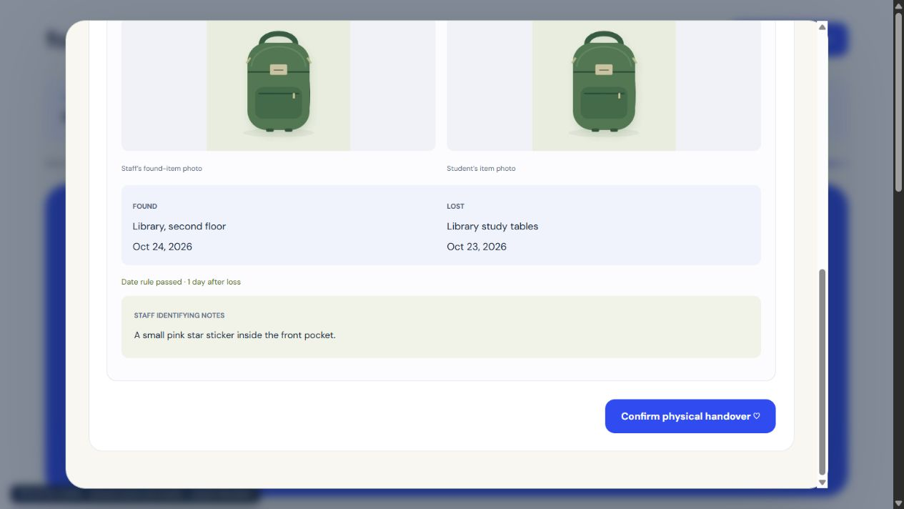
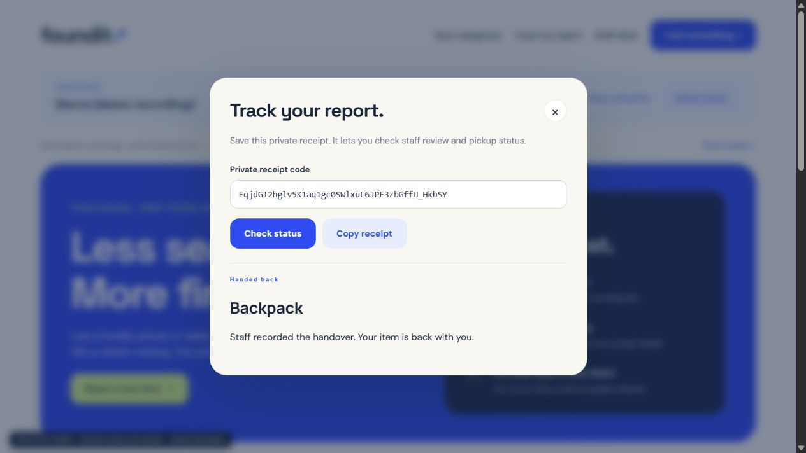
FOUNDIT / SIERRA SHOWCASE
7. Staff approve and record the return
Staff review the evidence, approve pickup, then confirm the physical handover.
Fictional workflow example using an original sample illustration. The score does not establish ownership.
08 / 11
Notes:
Approval and physical handover are separate staff actions. A private receipt lets the student check status without receiving match scores. Current source: school_app.py decide/track handlers.

Slide 9
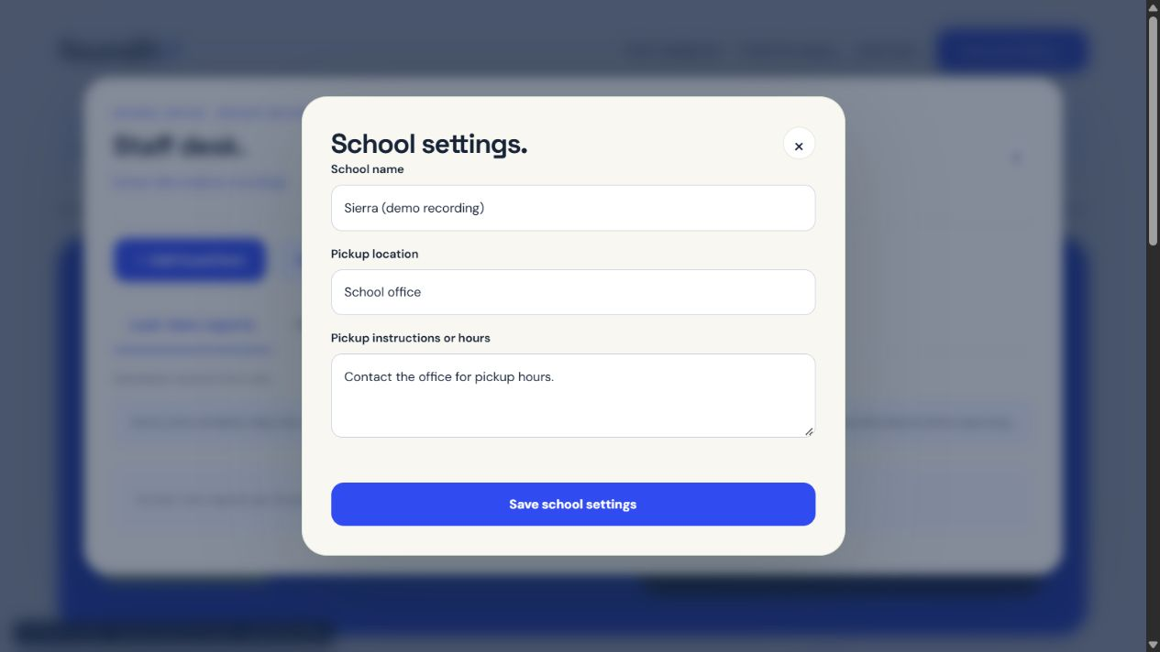
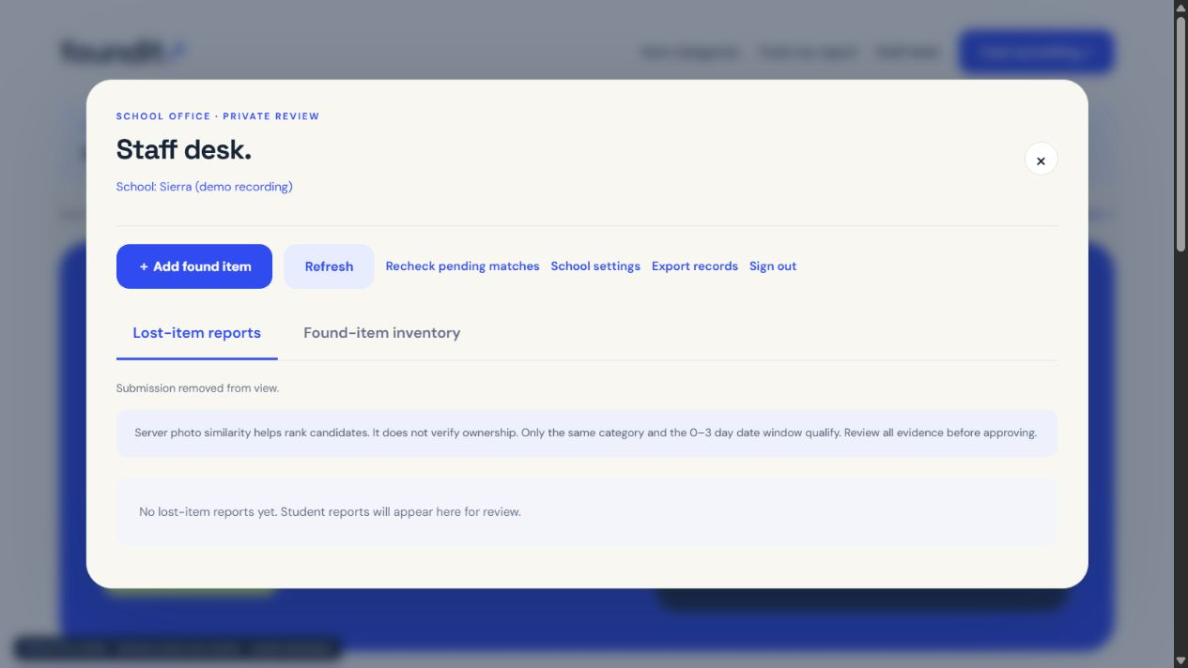
FOUNDIT / SIERRA SHOWCASE
8. Schools manage their own records
School name and pickup instructions
can be changed by that school’s staff.
Remove declined or handed-back items
from view while retaining history.
09 / 11
Notes:
Staff exports retain completed hidden records, and receipt status remains unchanged. Staff queries, exports, photo matching, review, and receipt tracking are scoped to the selected school. Sources: current school_app.py and regression tests.

Slide 10
FOUNDIT / SIERRA SHOWCASE
How it was built and what was difficult
THE BUILD
THE CHALLENGES
Python + Flask
SQLite with separate school records
HTML, CSS, and JavaScript
Limited server memory
A small image model keeps inference practical.
Private school records
Every query checks the school boundary.
Server photo matching:
MobileNetV2 + ONNX Runtime
NumPy and Pillow
Trustworthy returns
Staff decide after reviewing the evidence.
Pretrained ImageNet features from ONNX Model Zoo, Apache 2.0. No model training or real-school accuracy is claimed.
10 / 11
Notes:
The classifier head was removed from the ONNX Model Zoo MobileNetV2 model to use the 1280-dimensional global average pooling features. Source model: https://huggingface.co/onnxmodelzoo/mobilenetv2-12. Production stack includes Gunicorn and Nginx. Tests: 26 backend regression checks plus UI and deployed isolated checks; no school pilot or measured recovery impact claimed.

Slide 11
FOUNDIT / SIERRA SHOWCASE
Sierra’s board is ready to try
sierra-70912b
foundit.lunarelevation.com
School code or a shared school link opens the right board.
Real school code. Separate school records.
A person reviews every return.
Created for the Sierra showcase. Demonstration belongings and student details are fictional.
11 / 11
Notes:
Live Sierra link: https://foundit.lunarelevation.com/?school=sierra-70912b. Website and original assets were created for the hackathon with AI coding assistance. Pretrained model and tools are credited.

